Slide 1
IBM University Engagement Project Submission
“Exploring the Power of Agentic AI with IBM Granite and LangFlow”

Slide 2

Project Tile – Course Content Simplification Agent
(Problem No : 19)
Domain of Project – Education
Student Name | Recent Passport Photo | Email ID | Mobile number [WhatsApp]
Dikshant Ojha |  | 202501100038@mitaoe.ac.in | 7304753830

Slide 3
Problem Statement -
Problem Statement : Course Content Simplification Agent
The Challenge
Academic content often presents significant barriers to student learning:
• Complex jargon and technical terminology make study materials difficult to understand
• Students spend excessive time deciphering dense explanations and lengthy passages
• One-size-fits-all educational resources don't adapt to different learning levels (Beginner/Intermediate/Expert)
• Limited access to personalized explanations and simplified versions of course materials
• Students struggle to connect academic concepts to real-world applications
The Objective
Develop Atlas AI, an intelligent AI-powered Course Content Simplification Agent that transforms complex academic material into clear, understandable content tailored to individual learning levels.
The proposed solution aims to:
• Simplify complex course content while preserving technical accuracy
• Provide multi-level explanations (Beginner → Intermediate → Expert)
• Support multiple languages for broader accessibility (English, Hindi, Marathi, Tamil, Telugu, Bengali, Kannada)
• Generate jargon-busting definitions and real-world analogies for better comprehension
• Enable document-aware Q&A through Retrieval-Augmented Generation (RAG)
• Deliver personalized learning assistance at scale

Slide 4
Proposed Solution -
Proposed Solution: Atlas AI (Your Intelligent Learning Companion) Translate, Learn, Ask, Create
Atlas AI is an intelligent course content simplification agent built with IBM Granite models and Retrieval-Augmented Generation (RAG) to make learning accessible and personalized.
Key Features:
1. Content Simplification Engine
• Analyzes complex academic text and rewrites it for target proficiency levels
• Preserves technical accuracy while ensuring clarity and readability
• Supports multiple output languages for regional and international students
2. Intelligent Jargon Management
• Automatically extracts technical terms from content
• Provides simple definitions accessible to beginners
• Creates real-world analogies to connect abstract concepts
3. Retrieval-Augmented Generation (RAG)
• Extracts text from uploaded PDF/TXT documents
• Builds a FAISS vector index for semantic document search
• Enables document-aware Q&A grounded in actual study material
4. Multi-Level Learning Support
• Beginner Level: Simple language, short sentences, no jargon
• Intermediate Level: Clear explanations with key terms introduced
• Expert Level: Academic rigor with simplified complex sentences
5. User-Friendly Dashboard (Streamlit)
• Tab 1: Content Simplifier for direct text input or document upload
• Tab 2: RAG Chat for asking questions about uploaded documents
• Real-time processing with instant results

Slide 5
Technology Used
Python:
Core programming language for backend logic and agent orchestration
IBM Granite:
Foundation model (ibm/granite-3-3-8b-instruct) for NLU, summarization, and content generation
Streamlit:
Interactive web framework for building responsive user interface
IBM Watsonx.ai:
Cloud platform for model deployment, embeddings, and AI governance
RAG Architecture:
Retrieval-Augmented Generation for document-grounded Q&A
FAISS:
Facebook AI Similarity Search for high-speed vector indexing and retrieval
SentenceTransformers:
all-MiniLM-L6-v2 model for semantic text embeddings
PyPDF & Text Processing:
PDF extraction and text chunking for document processing

Slide 6
System Architecture Components
Logical Components (Implemented in Python):
1) File Upload Component – Accepts PDF, TXT, and text input from users
2) Text Extraction Module – Extracts and preprocesses content from documents
3) Text Chunking & Embedding – Splits text into semantic chunks and creates vector embeddings using SentenceTransformers
4) FAISS Vector Index – Stores embeddings for fast semantic search and retrieval
5) IBM Granite LLM Component – Processes simplification requests and generates context-aware responses
6) RAG Retrieval Pipeline – Fetches relevant document chunks based on semantic similarity
7) Streamlit UI Component – Provides interactive tabs for content simplification and document Q&A
8) Session State Manager – Maintains chat history and document context across interactions

Slide 7
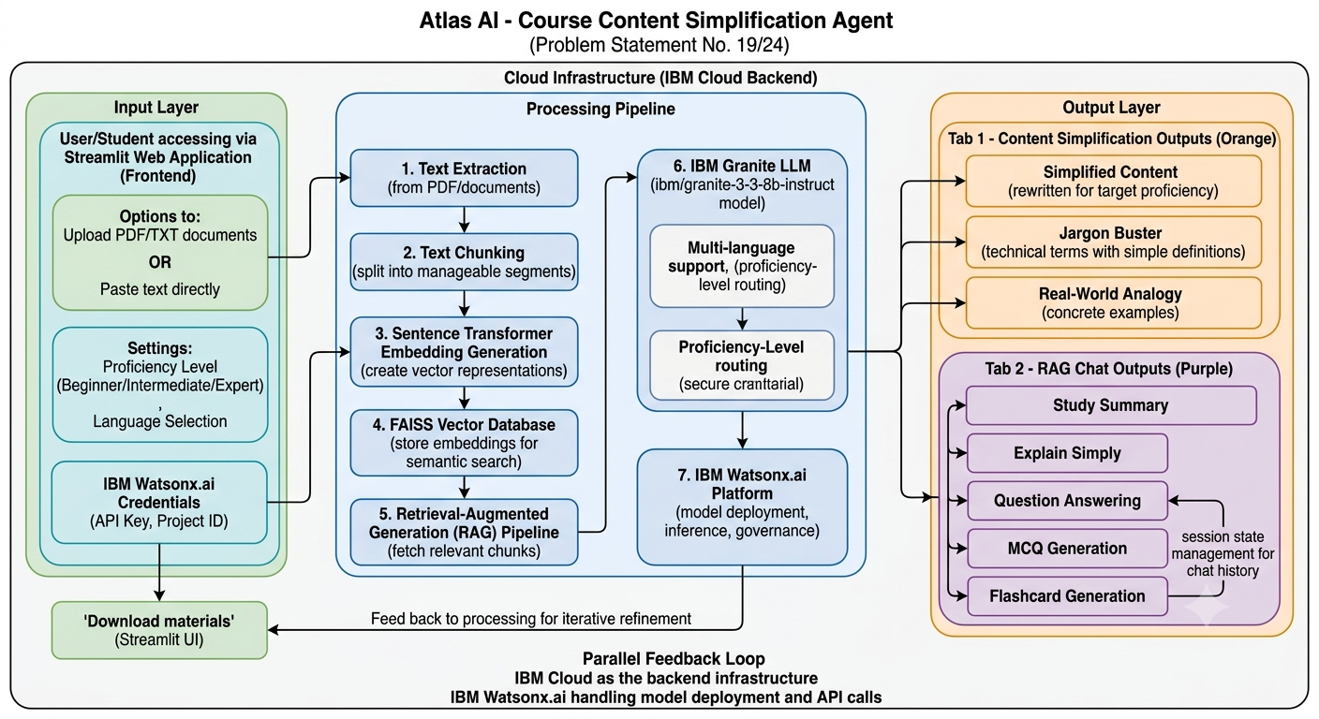
Architecture blueprint

Slide 8
Role of Agentic AI in Atlas AI
How Atlas AI Leverages Agentic AI & IBM Granite:
Intelligent Specialization
• The simplification agent specializes in understanding academic content and user proficiency levels
• Adapts responses dynamically based on target audience and language preferences
• Maintains context awareness throughout multi-turn conversations
Context-Aware Processing
• Understands user inputs (proficiency level, language, domain context)
• Generates responses that match cognitive level while preserving technical accuracy
• Retrieves relevant information from documents through intelligent semantic search
Multi-Agent Collaboration
• Simplification Agent: Rewrites complex text for target proficiency level
• Jargon Analyzer: Extracts and defines technical terms contextually
• Analogy Generator: Creates real-world connections to abstract concepts
• RAG Retrieval Agent: Fetches document-grounded information for Q&A
Real-Time Adaptation
• Continuously learns from user interactions and feedback
• Adjusts explanation depth and language complexity on demand
• Supports multiple regional languages dynamically
Personalization at Scale
• Tailors learning experience to individual student needs
• Provides multi-level content (Beginner → Expert) from single source material
• Generates personalized study aids (summaries, analogies, practice questions)
Overall Impact
Saarthi AI transforms static educational resources into an intelligent, adaptive, and personalized learning companion that understands student needs and delivers targeted educational support.

Slide 9
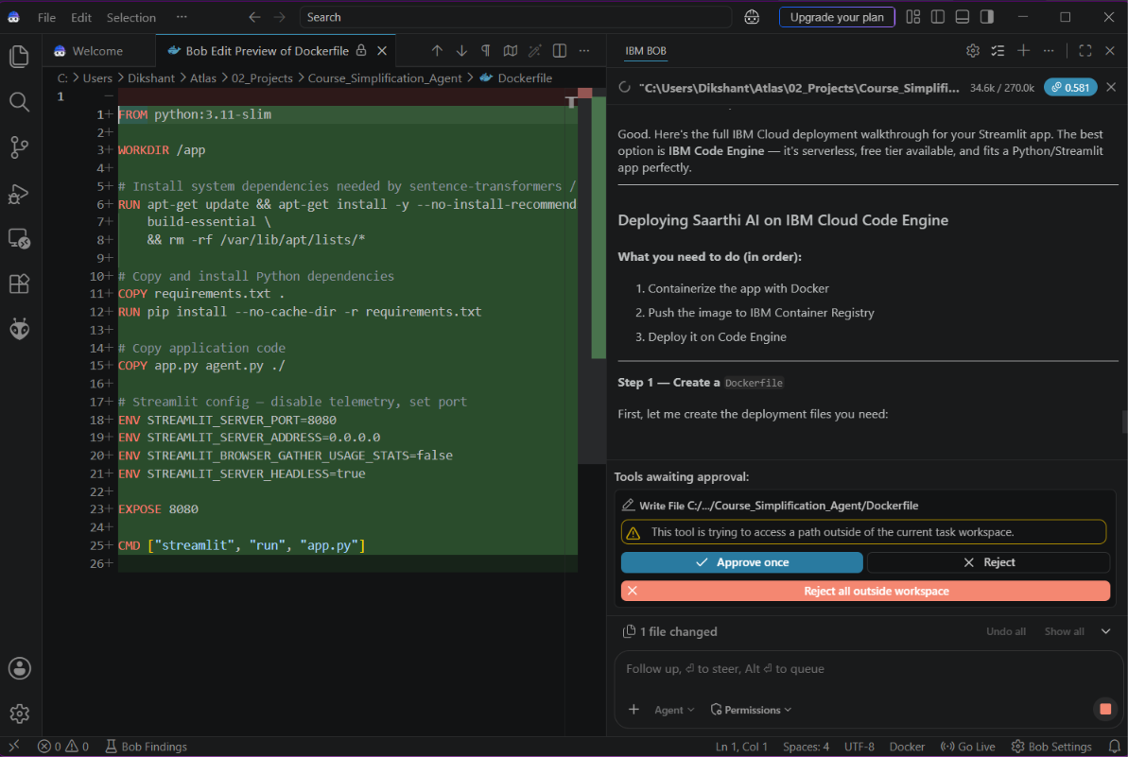
IBM BOB

Slide 10
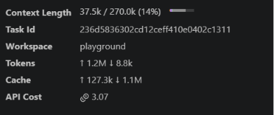
Token Usage
1.2M token are used
Resource Usage
·
·

Slide 11
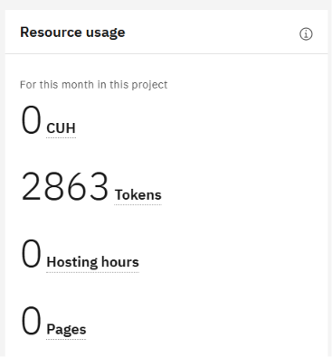
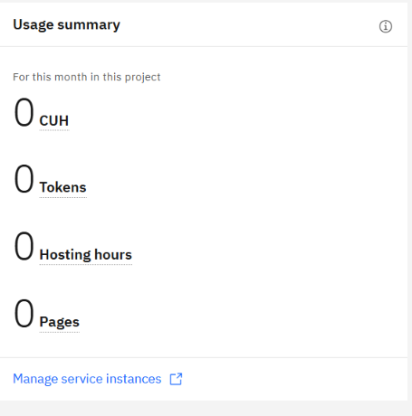
Token Usage
·
·

Slide 12
Novelty and Uniqueness
1. Educational Focus with Agentic AI – Combines AI agents specifically designed for learning simplification, not generic chatbots
2. Multi-Level Content Generation – Single source material generates Beginner/Intermediate/Expert versions automatically
3. RAG-Grounded Learning – Answers are strictly based on uploaded documents, reducing hallucinations and improving accuracy
4. Jargon-Centric Approach – Explicitly identifies, defines, and contextualizes technical terminology for all learner types
5. Real-World Analogy Generation – Creates concrete connections between abstract concepts and everyday experiences
6. Multilingual Support – Extends accessibility across Indian and international student populations
7. Document-Aware Q&A – RAG pipeline ensures all responses are grounded in actual study material, not generic knowledge
8. Proficiency-Adaptive Learning – Content complexity adjusts dynamically based on learner level
9. Transparent AI Processing – Shows jargon definitions and reasoning, building student trust in AI assistance
10. Cloud-Ready Architecture – Deployable on IBM Cloud with built-in scalability and governance

Slide 13
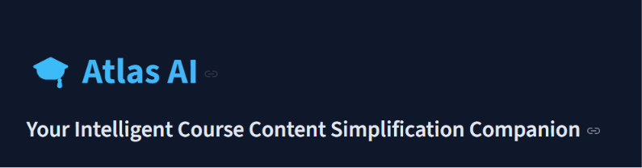
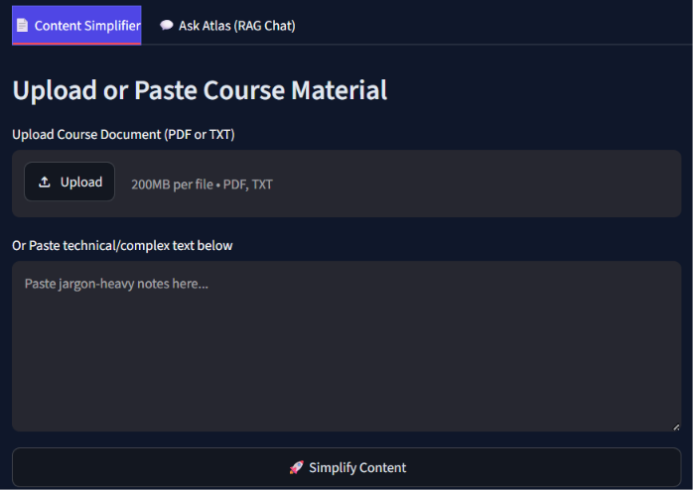
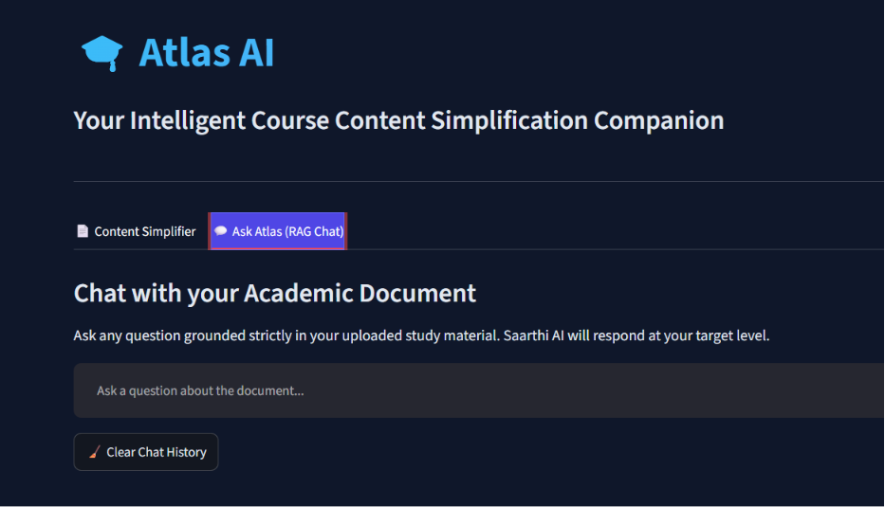
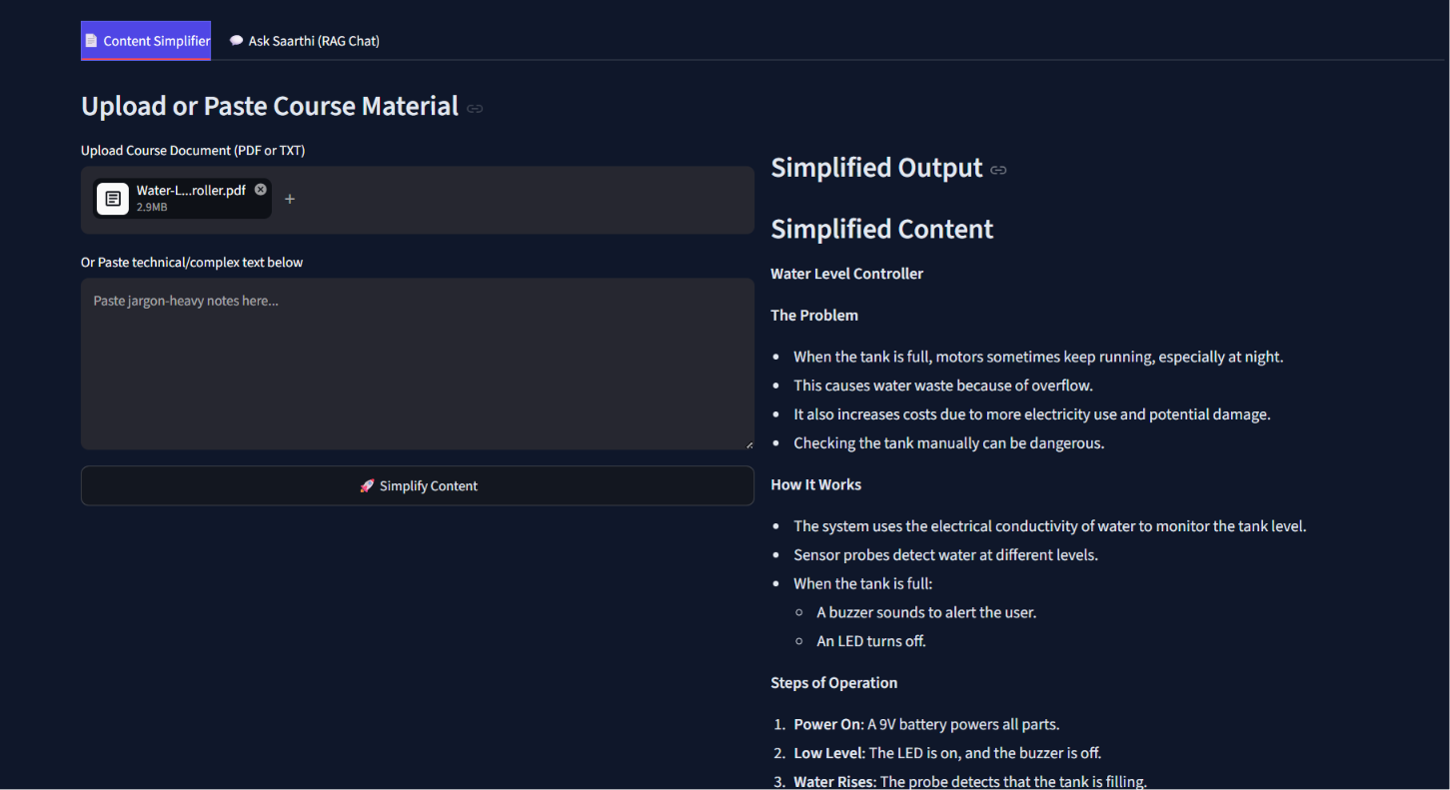
Some visuals

Slide 14
GITHUB LINK
https://github.com/Dikshant422/Atlas-AI

Slide 15
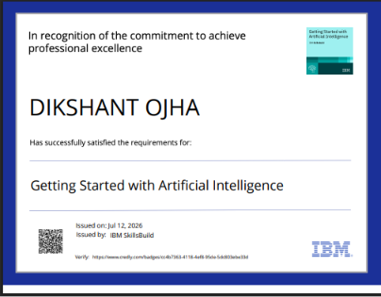
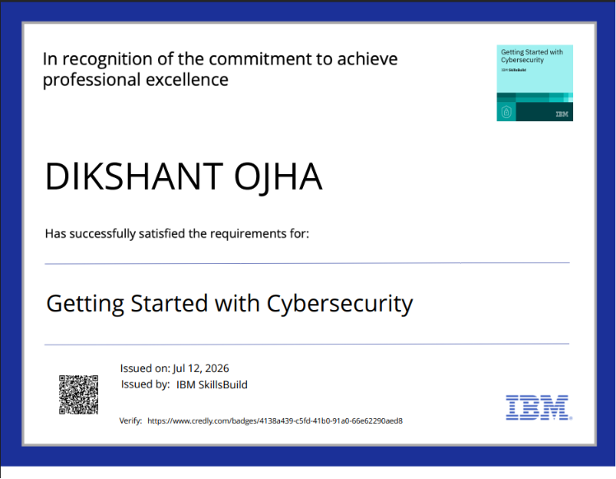
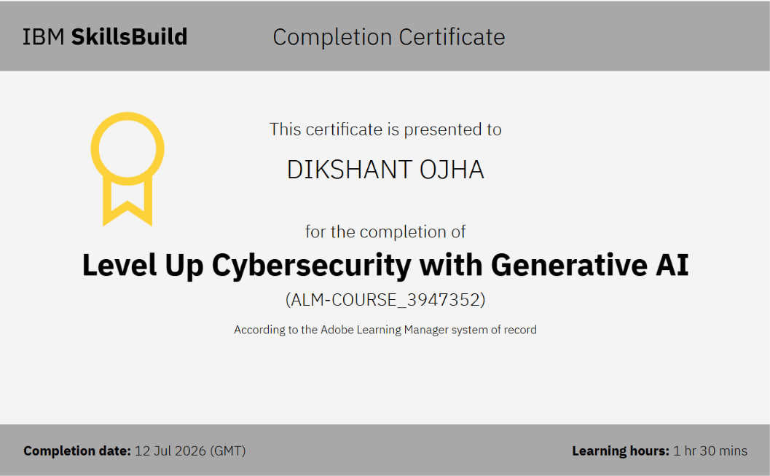
Certificates Earned:

Slide 16
Future Scope & Enhancement
1. Advanced Multi-Modal Learning
Integrate OCR to process scanned textbooks and handwritten notes; support voice input for accessibility
2. AI-Powered Assessment Generation
Auto-generate multiple-choice questions, short-answer prompts, essay questions, and interactive quizzes from content
3. Learning Analytics Dashboard
Track student progress, identify weak areas, provide personalized study recommendations based on performance
4. Collaborative Learning Features
Enable peer-to-peer learning, study group features, and shared annotation on simplified content
5. Mobile Applications
Develop iOS/Android apps for on-the-go learning with offline support for downloaded content
6. LMS Integration
Integrate with platforms like Moodle, Google Classroom, Canvas for seamless institution-wide deployment
7. Advanced RAG with Web Integration
Extend RAG to fetch real-time information from web sources, academic databases, and research papers

Slide 17
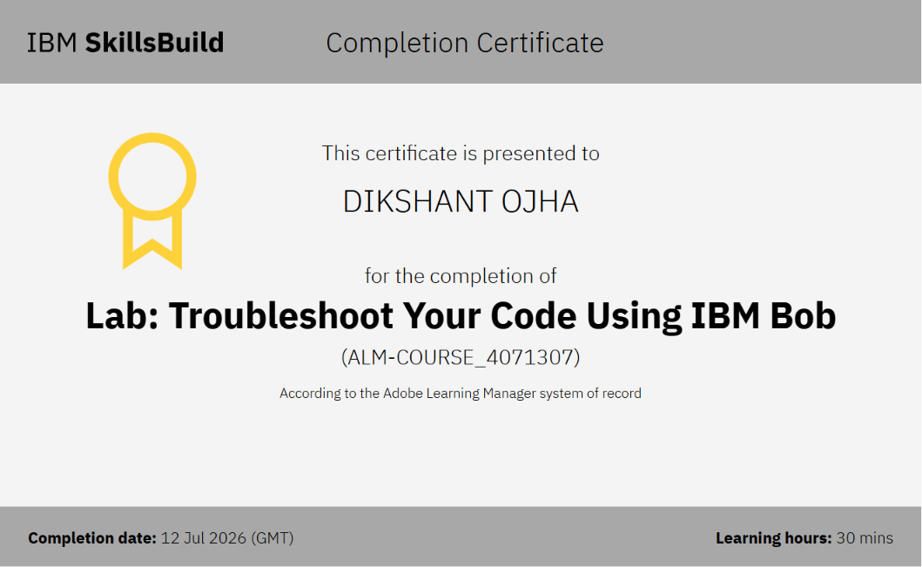
Certificates Earned:​
IBM BOB Certificate

Slide 18
Technical Implementation Note
The application is built with IBM Granite integration through the ibm-watsonx-ai SDK.
The system supports both live IBM Watsonx mode (with valid credentials) and a full-featured Demo Mode
that simulates the exact same interface and behavior for demonstration purposes.
All core functionality—content simplification, RAG-based Q&A, multi-level support, and language
handling—works identically in both modes. The Demo Mode is fully functional for showcasing the
application without requiring active API credentials.
Complete source code with both modes is available in the GitHub repository, demonstrating
enterprise-ready architecture suitable for educational deployment.

Slide 19


